Slide 1
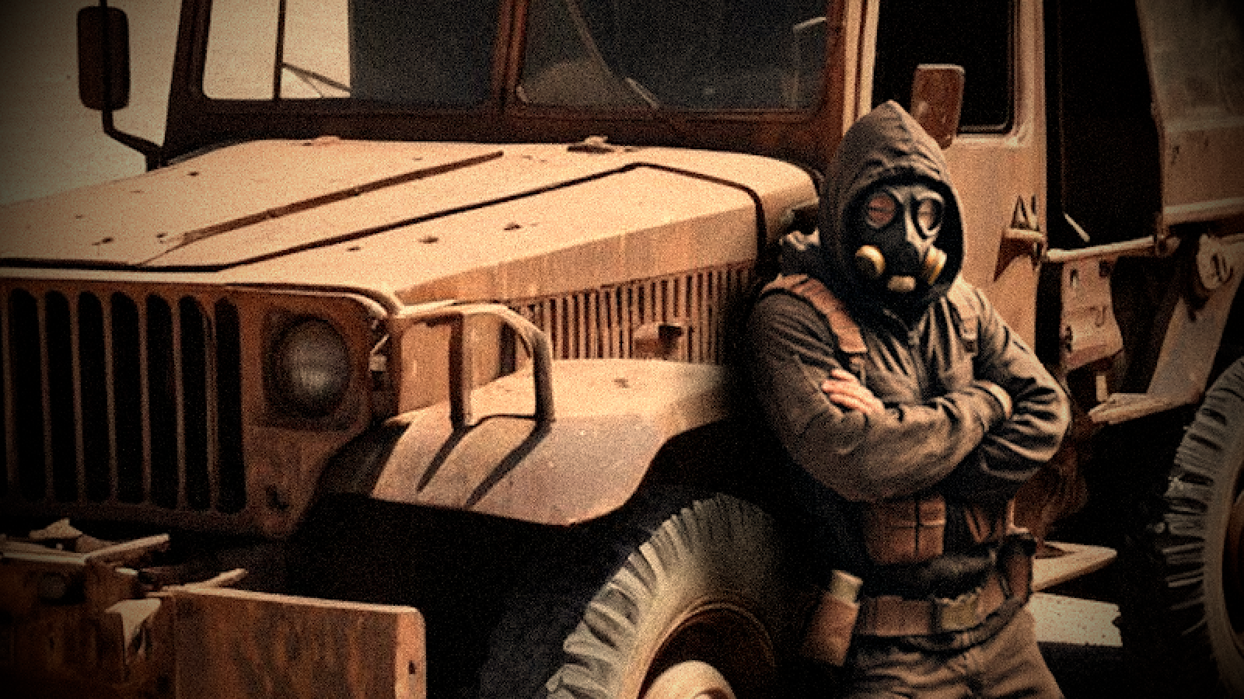
Apocalyptic Merchant Game
Implemented by:
Dylan Brunelle, Tom Roller, Daniel Kim and Mitchell Jones

Slide 2
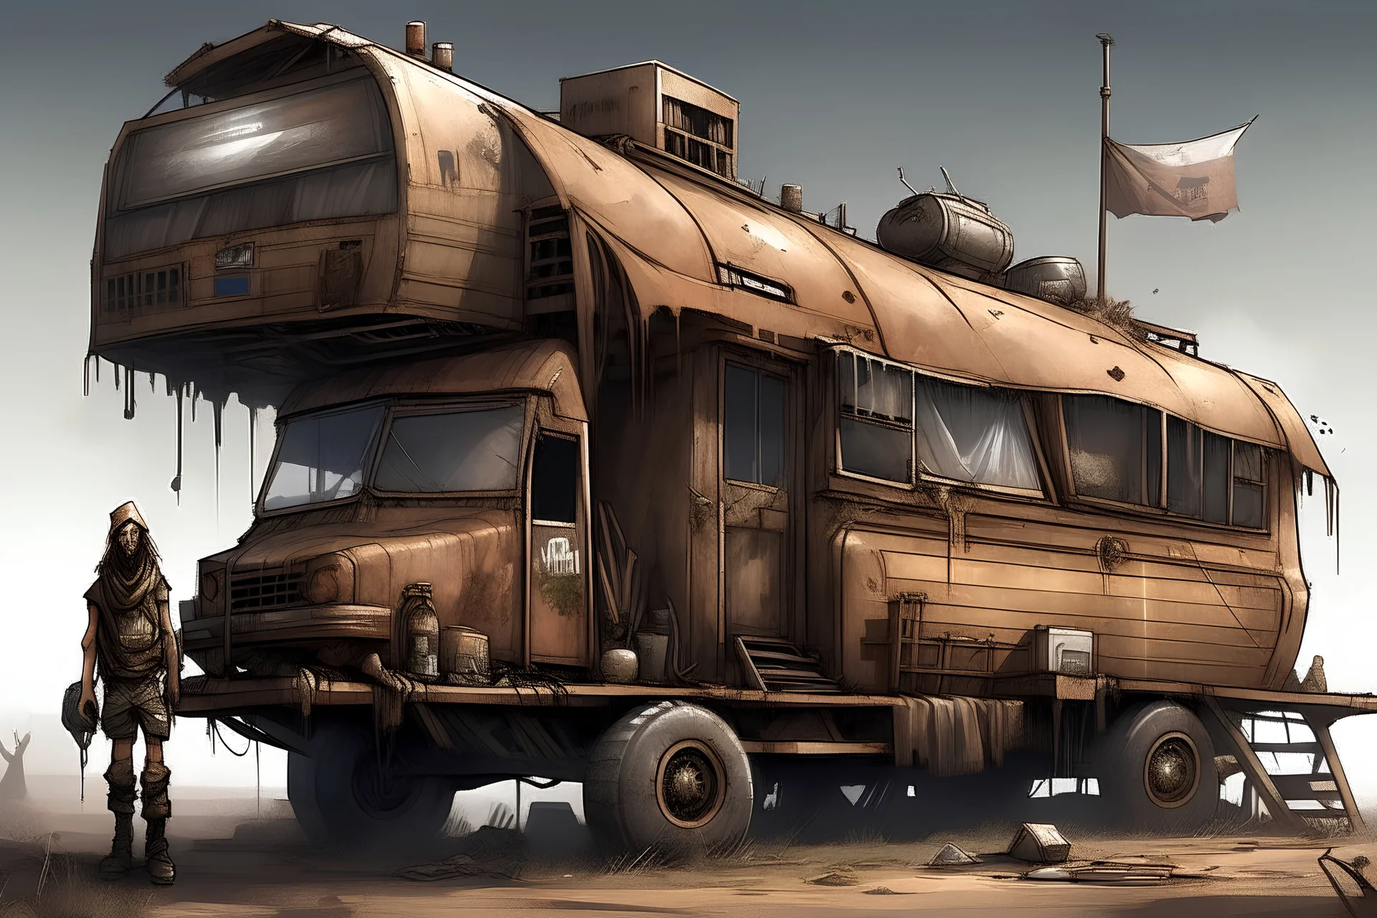
Acknowledgements
This project is based on a project specification of the same name
CS 440 Fall 2019 Group 4: Apocalyptic Merchant Game (Theme: Travelling Knapsack Applications II)
We credit the following individuals for coming up with the original project idea
Brian De Villa
Daniel Kahl
Jonel Alcasid
Jonathan Uhlmann

Slide 3
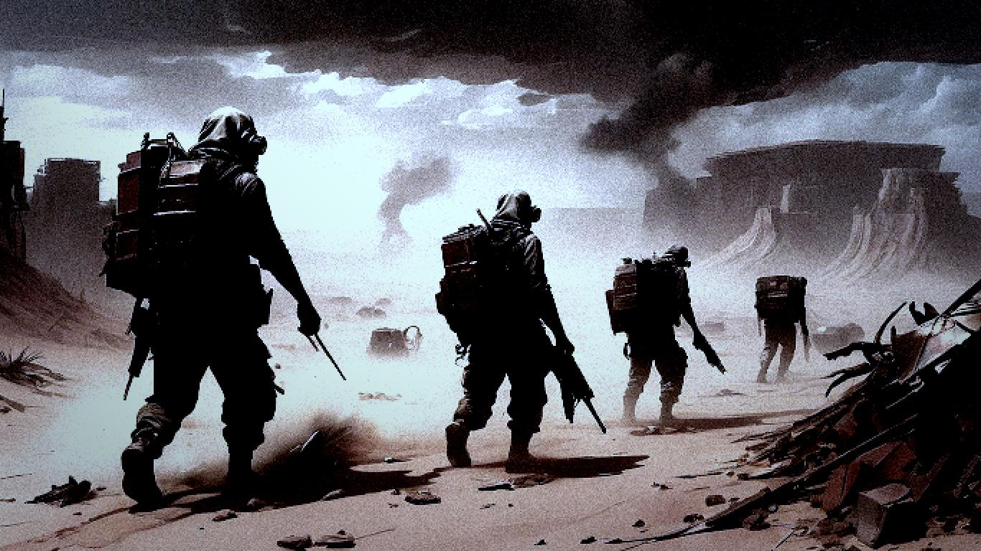
DEMO

Slide 4


What went well?
Same methodology as in CS 440
Scrum
Weekly Sprints
Product Backlog/Stories
Jira
Frequent communication
Usually met in-person Monday, Wednesday, and Fridays
Everyone active on Discord for quick communication
Multiple shared design documents of various characters, plotlines, and items to all be on the same page

Slide 5

Problems we faced?
We were a little too ambitious
Scope of game narrative too large to fully accomplish in two weeks
Despite achieving all functionality discussed in scenario documents, continuously added new features to the backlog purely for the sake of “It would be cool if…”
Limited knowledge of the engine made implementing some of these features too difficult to implement without further research
Many features exceeded what was in the original project documentation, required extra to design as well as implement
Not enough time
Too many features and character interactions to thoroughly test before the presentation date
Resulted in a lot of cut content/features

Slide 6



Recommendations
Communication is key
Understand time constraints
Understand your limits
What is realistically achievable

Slide 7

The End

